Slide 1

SLIDE 1
Team Innov8
2. Shakthi T(9884210067),
Madhur Padavala 8825557190
Niyantha M 9791364643
3. Open Innovation
4. Mood Recognizing Playlist Finder(GroovFind)

Slide 2
SLIDE 2
Abstract
Over the years we realized that AI should work in the direction of detecting human emotion and help the person in their terms. During these pandemic times one sure does misses out on a lot, the only thing that transcends and act as his support system is listening to some light music or a music that defines his mood.
With the growth of AI and ML, the detection of human emotion cannot be only observed clearly from one’s voice but their expressions too.

Slide 3
SLIDE 3
So we have been working on a project which has the ability to detect one's facial expression and predict the emotion from your web camera, our intelligent web application will play a provide you a number of playlist that u need at the particular moment. If someone is way too worried or distracted up to the extent that he is unable to sleep then our ‘GroovFind’ will play the perfect grooving , soothing tunes that let him relax and hit the bed peacefully.

Slide 4
SLIDE 4
NOVELTY
Despite the humongous growth of AI has brought various libraries and numerous projects that can establish our work. We have not went the usual way of building and training the model from scratch and using Kaggle dataset but whereas we are using the face-api-js which enables us to create an realtime face detection algorithm using which we have enhanced It to mood recognition algorithm through which we collect the data and provide the suggestion through our web application thus proving to be a novel approach.

Slide 5
SLIDE 5
TECHNOLOGY STACK
Our project being a web application so we had to create frontend and backend technologies like HTML,CSS,JS, Face-api-js, express, node js, ejs templating and Figma to create the prototype

Slide 6
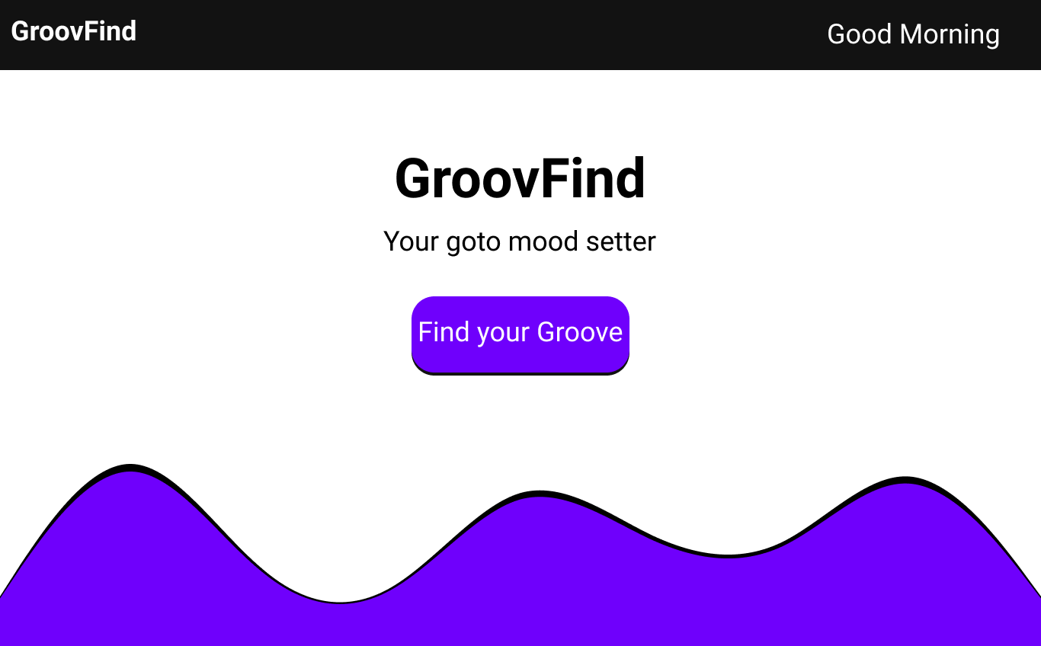
SLIDE 6
SOFTWARE IMPLEMENTATION
The project is heavily dependent on the frontend stack and API fetching through the face-api-js through which we are able to access the web cam of the user in the web application for which the prototype was designed using Figma and it was hard coded using HTML,CSS, Js, node js, express for routing and ejs for templating through which we established the frontend and routing part of the website so far and the backend is yet to be done where the functionality of the web application that detects and gives result is on progress

Slide 7
SLIDE 6
BUSINESS SCOPE
With the demand for good music being ever growing field of interest for a very long time, coming up with solutions that helps in finding the right music based on the user’s mood can create higher demands for the streaming services that’s looking to cement their places on the user’s head. With GroovFind able to collaborate on a higher scale, it enables the streaming services to create a resounding experience in the users that will enable the the brand’s value to resonate in them for a very long time with the way this AI based tool is able to get closer with user’s emotion.

